Slide 1
Classifying the useful reviews on Yelp
BIA-660 Web Analytics Midterm Presentation
Zijing Huang, Po-Hsun Chen,
Hao-Wei Chen, Chao Shu
Department of Computer Science
2017.10.30

Slide 2
1. Business/Research Understanding Phase
What is a useful review?
Is that matters to find out the useful review?
3. Data Preparation Phase
How the data looks like?
How to filter the data?
4. Modeling Phase
Which methodology is going to be used?
How to implement the methodology above?
2. Data Understanding Phase
What’s the data we need?
Where the data comes from?
5. Evaluation Phase
How to evaluate the result?
How to apply the evaluation method?
6. Deployment Phase
What ‘s the output in this project?
How to deploy our apps？
Contents of the project
Notes:
1. For customer, for company and for yelp
2. The data is all supplied from Yelp. The Yelp dataset is a subset of the real businesses, reviews, and user data for use in personal, educational, and academic purposes
3. neural network
4. naive bayes

Slide 3
Business/Research Understanding Phase

Slide 4
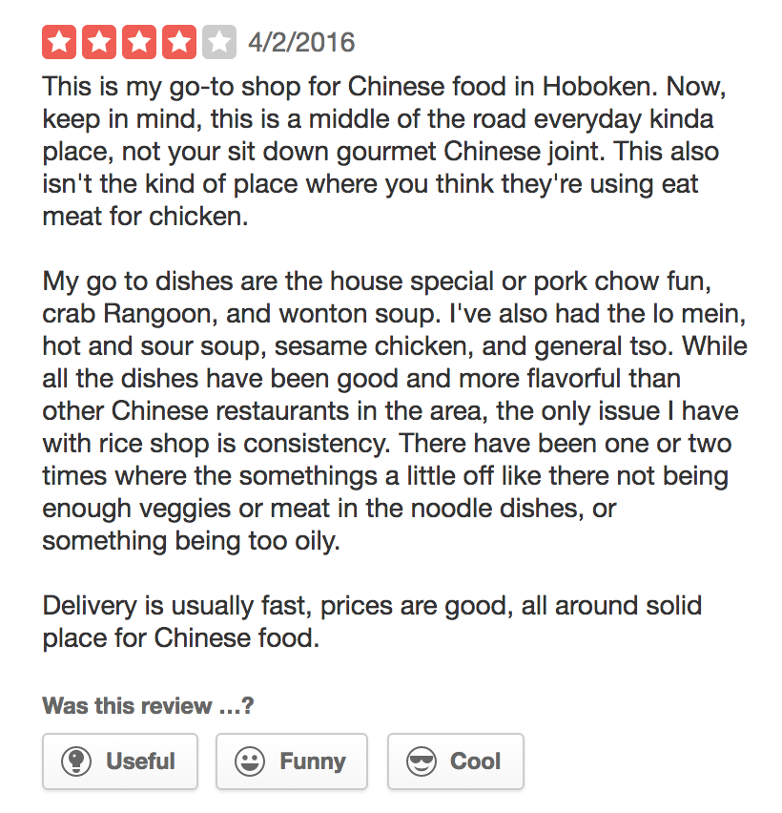
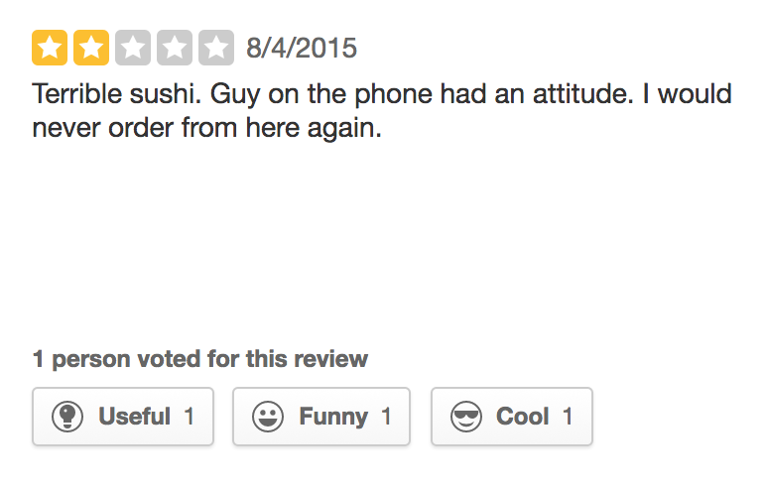
What is a useful review?
This is an relatively subjective review. The whole review is about she hates this and doesn’t like that. She fails to give the detail like how terrible the sushi is? Is the sushi too small or too spicy? What sushi she had?
This is a relatively objective review. There are details to support why it is good. If we break down the whole review sentences by sentences, we can find out that most of them is about “evidence”, which is hard to be classified as positive/negative.
Notes:
In the very first step, we are going to define what a useful review is.
In the left side of the review, we can tell that it is subjective because it just showed that reviewer didn’t like the food but any detail such as how or why
In the right side of the review, it is an objective review. It supplied the sufficient information about the customer’s experience about the restaurant. Its hard to be classified as positive or negative, but the neutral review usually supplied more information and it means more useful to the users.

Slide 5
Commercial potential
Is that matters to find out the useful review?
For customers: customers are more likely to read the reviews with details instead of the reviews who just wrote to express attitude. For example, saying ”The steak is crispy and juicy” is more attractable compared to “It is good and I like this steak”.
For companies: companies need the objective reviews. The positive reviews get word of mouth for the business. Even the negative one can help them improve their products.
For Yelp: Reject the paid poster. More and more objective reviews increase the community activity, which attracts more and more users to register.
Notes:
In this project, it can assist Yelp to filter those un-useful reviews or those reviews which is from the paid poster who always say something good to the restaurant and never mention about how and why. It will supply more objective and useful reviews to the users and attract more people to be willing to use it.

Slide 6
Data Understanding Phase

Slide 7




The Yelp Dataset
The data are provided by Yelp Dataset Challenge, which is an opportunity for students to conduct research or analysis and share their discoveries.
The Yelp dataset is a subset of the real businesses, reviews, and user data for use in personal, educational, and academic purposes.
Include 4,700,000 reviews, 156,000 businesses, 200,000 pictures, 12 metropolitan areas.
Available in both JSON and SQL files
4,700,000 reviews
156,000 businesses
200,000 pictures
12 metropolitan areas

Slide 8
Data Preparation Phase

Slide 9
How the data looks like?
Download the 2GB yelp_dataset.tar from yelp’s official website, which contains 4736897 reviews.
Each review looks like as the figure on the right.
Use “head -n100 /Users/huangzijing/Downloads/dataset/review.json >> yelp.data” to copy the first 100 reviews into yelp.data
Run the prepocessor.py to clean and prepocess the data, and change it into data_set.csv.
{
"review_id":"VfBHSwC5Vz_pbFluy07i9Q",
"user_id":"cjpdDjZyprfyDG3RlkVG3w",
"business_id":"uYHaNptLzDLoV_JZ_MuzUA",
"stars":5,"date":"2016-07-12",
"text":"My girlfriend and I stayed here for 3 nights and loved it. The location of this hotel and very decent price makes this an amazing deal. When you walk out the front door Scott Monument and Princes street are right in front of you, Edinburgh Castle and the Royal Mile is a 2 minute walk via a close right around the corner, and there are so many hidden gems nearby including Calton Hill and the newly opened Arches that made this location incredible.\n\nThe hotel itself was also very nice with a reasonably priced bar, very considerate staff, and small but comfortable rooms with excellent bathrooms and showers. Only two minor complaints are no telephones in room for room service (not a huge deal for us) and no AC in the room, but they have huge windows which can be fully opened. The staff were incredible though, letting us borrow umbrellas for the rain, giving us maps and directions, and also when we had lost our only UK adapter for charging our phones gave us a very fancy one for free.\n\nI would highly recommend this hotel to friends, and when I return to Edinburgh (which I most definitely will) I will be staying here without any hesitation.",
"useful":0,"funny":0,"cool":0}

Slide 10
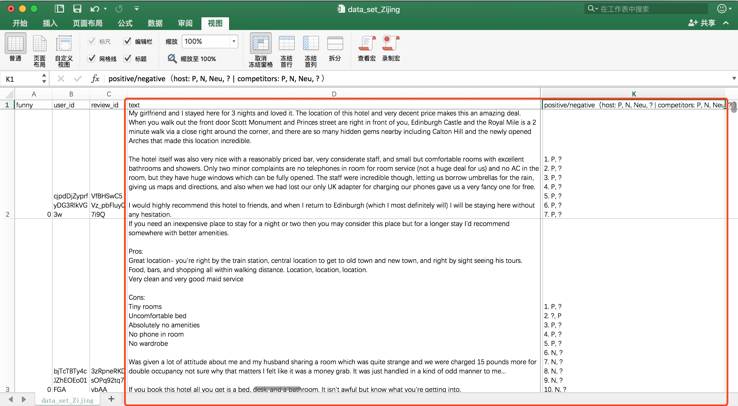
How to filter and train the data?

Slide 11
Modeling Phase

Slide 12
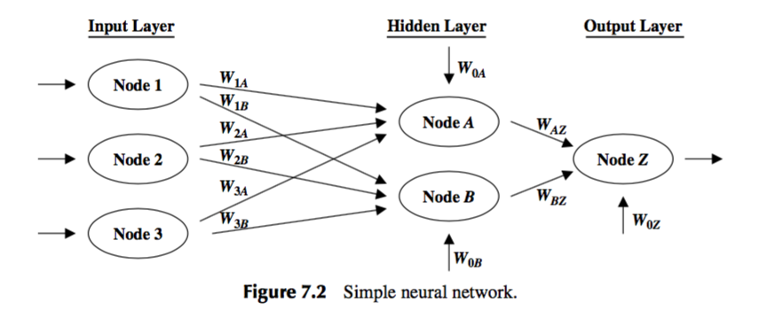
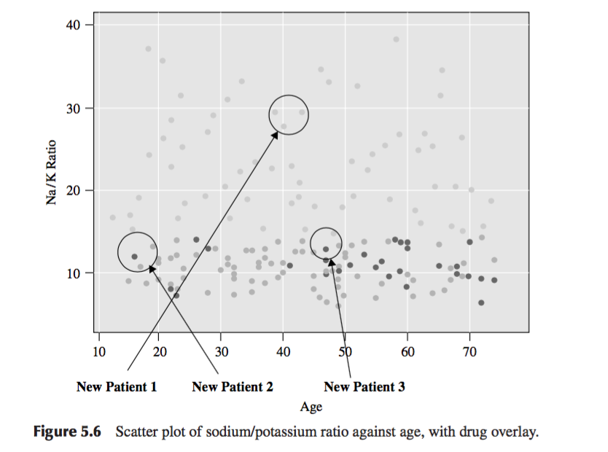
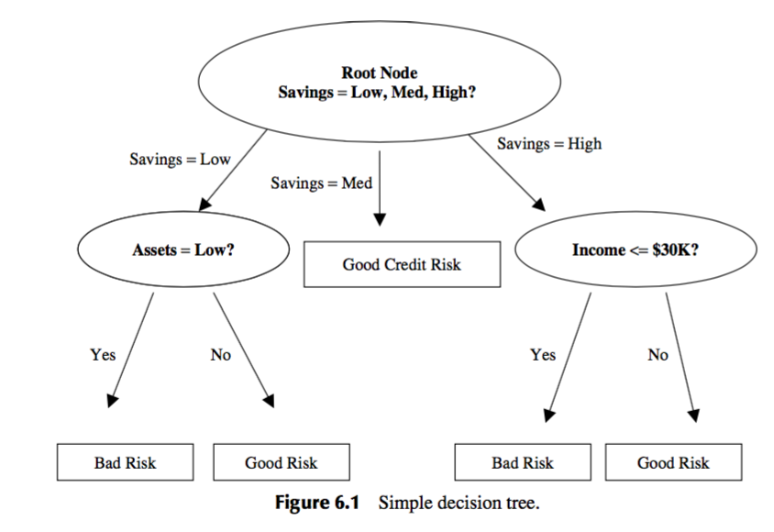
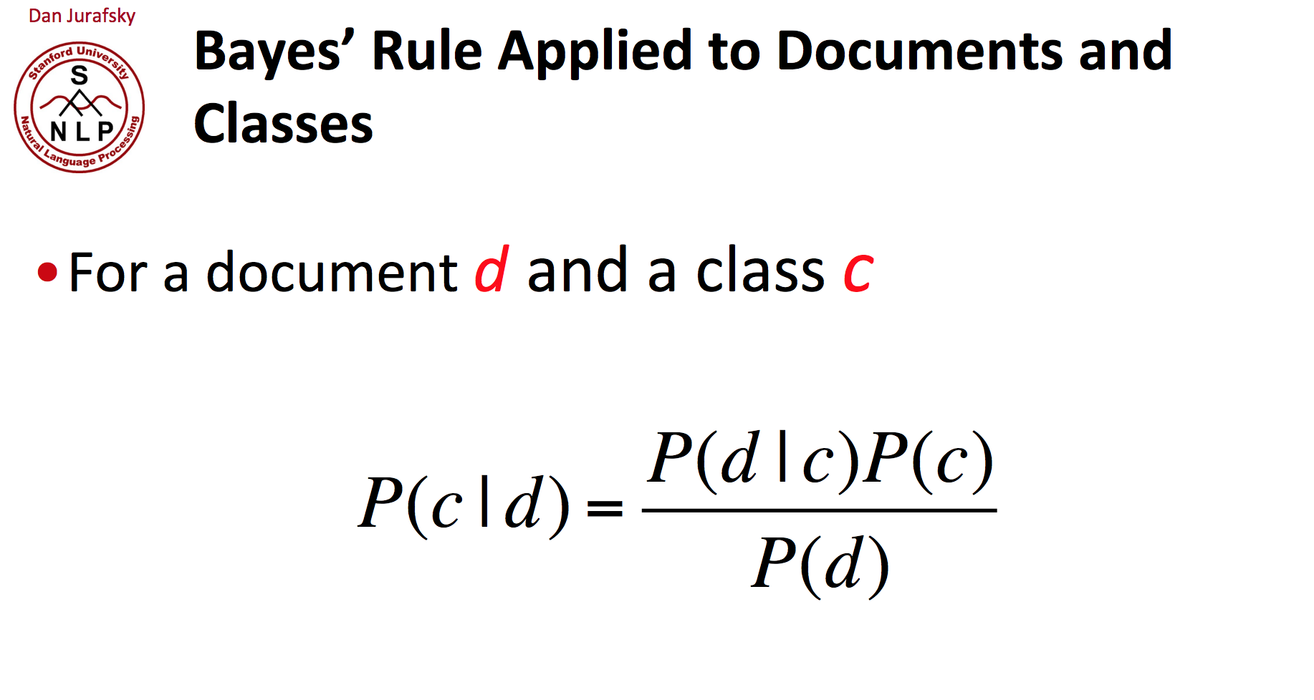
How do we choose the methodology
Supervised Learning (classification)
KNN, decision tree, Naïve Bayes, Neural Network
One of the advantages of using neural networks is that they are quite robust with respect to noisy data
Noisy data is data that is corrupted, or distorted, or has a low Signal-to-Noise Ratio.
Notes:
After cleaning and labeling the data, we have to choose a methodology to train them.
Since our target is to classify the documents into different categories, we would use supervised learning in this case.
So we have many choices, such as Knn, decision tree, Naive Bayes or Neural network.
We prefer Neural network because it respects to noisy data, which is data that is corrupted or distorted.
The next step is to train the neural network

Slide 13
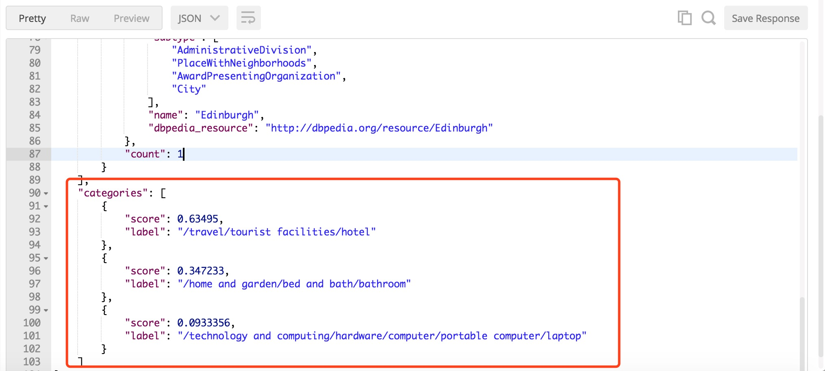
How do we train the neural network
tfidf of Keyword A
net_{A} = W_{iA}x_{iA} = W_{0A}(1)+W_{1A}x_{1A} +W_{2A}x_{2A} +W_{3A}x3A + … + W_{iA}x_{iA}
f (net_{B}) = Y = 1/(1+e^{-x})
Train to get the most reasonable thresholds and weight
Randomly initialize W_{i}, waiting for trainning
labels
tfidf of Keyword B
Notes:
Firstly, we compute the value of Tf-Idf of each keywords as the input layer.
And then we randomly initialize the weight and the neural in the hidden layers.
Generally speaking, the more nodes we get in the middle layer, the more accurate the output we have.
Finally we adjust the value of weights and thresholds base on the training result.
Here we use a python library called PyBrain to simulate the process of building a neural network.

Slide 14
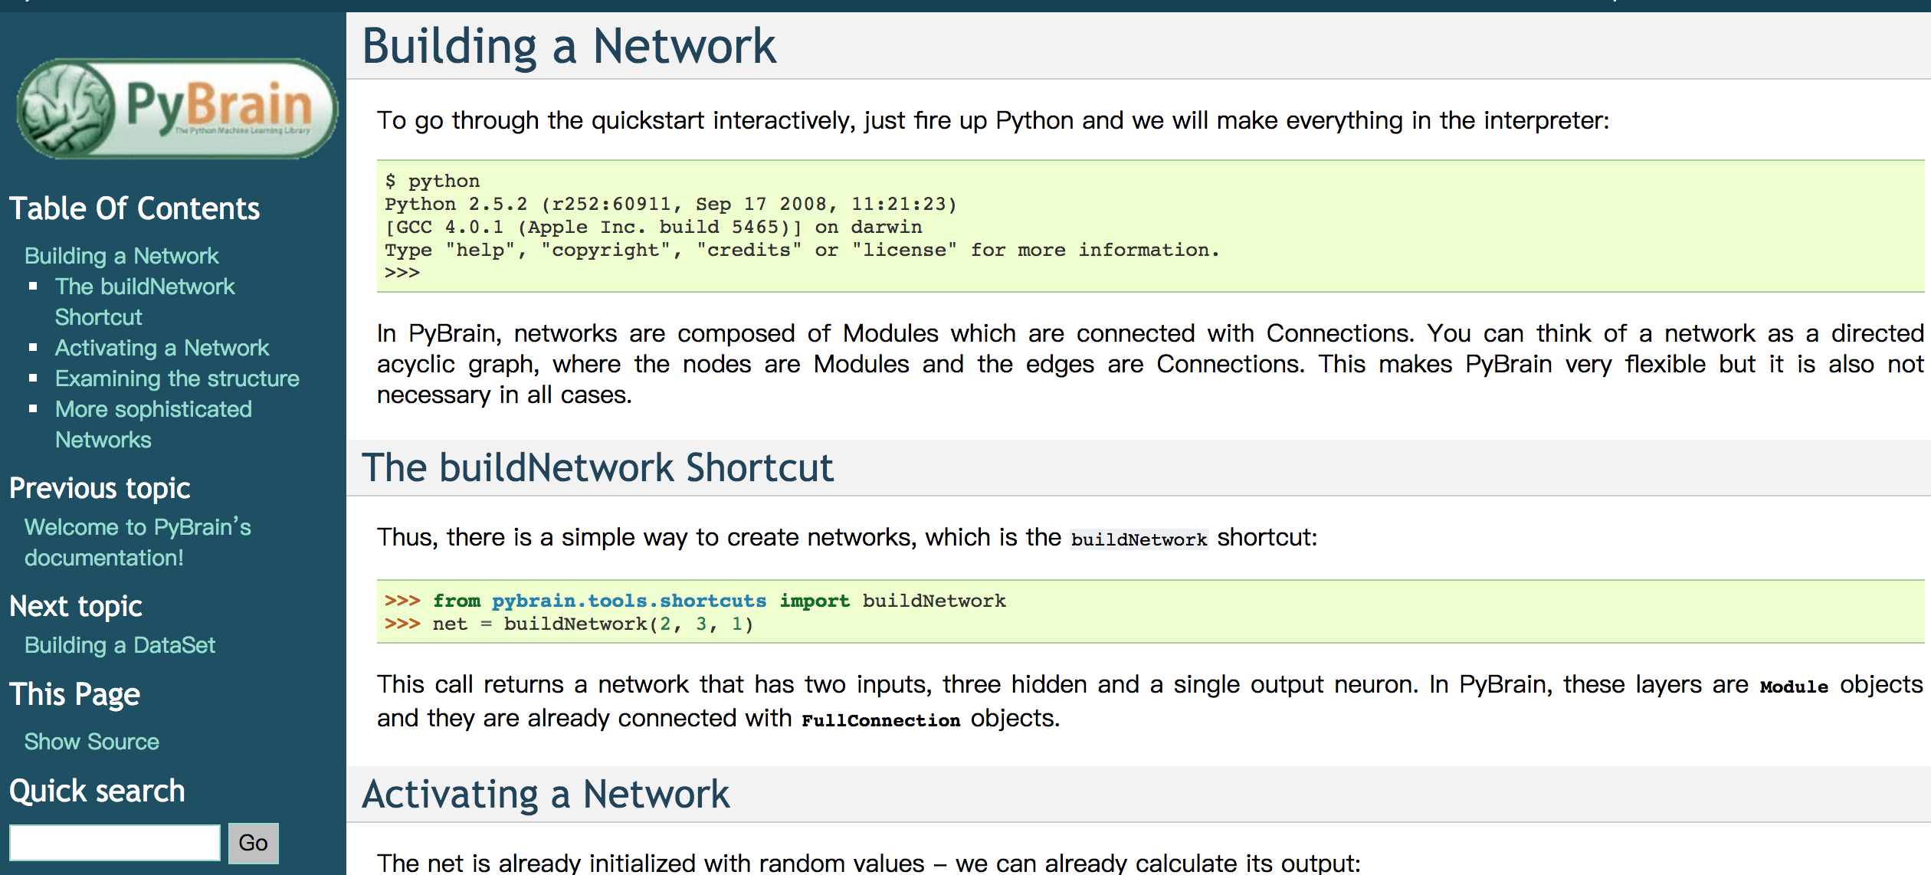
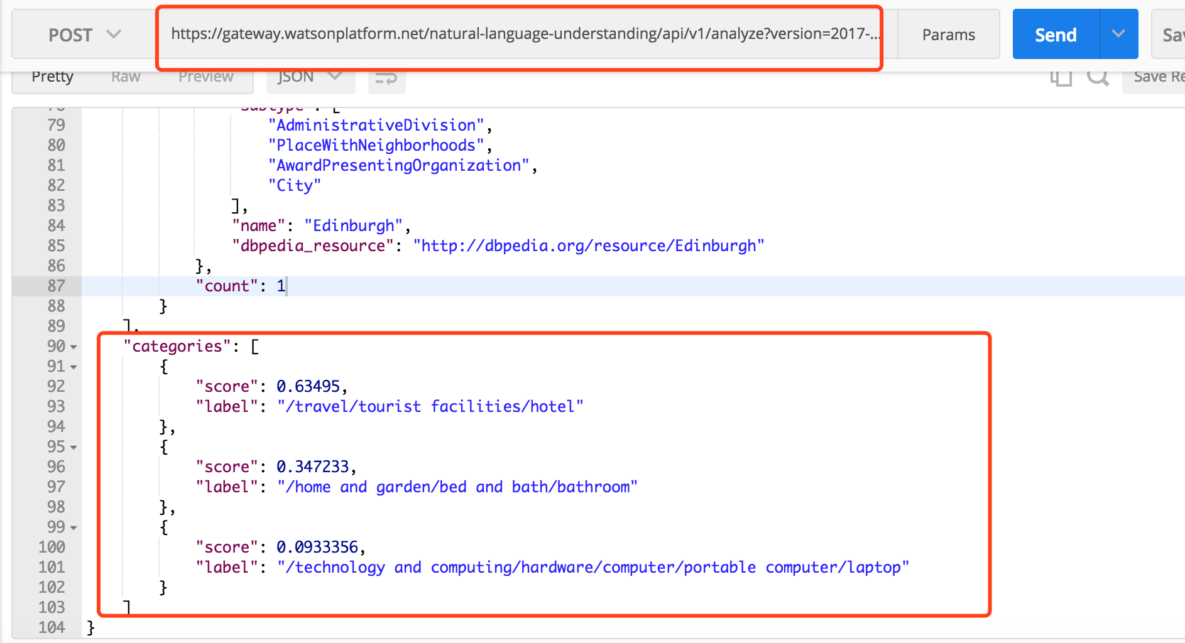
Implement neural network in python
Use a python library such as PyBrain to build a neural network.
Train the data to get the suitable Weight and thresholds, which means we can get our own model.
Use a Restful-API provided by IBM Bluemix to examine the result.
Notes:
PyBrain provides us some APIs to build a neural network, to train the dataset and classify the dataset.
And then We can follow the flow chart to build our own neural network.
After building our own neural network, when we input a review, the output would be the sentiment and categories of each sentence about the review.
Eventually we can compare our output with the output from IBM’s neural network as the image shows in the left.

Slide 15
The limitation of the neural network
Needs a huge training data to produce the precise output.
Cost a long time to construct a robust neural network
Hard to explain the meaning of each neural and layer.
Notes:
But neural network still has its limitation.
This is kind of trade off.
So far, we went through what is neural network, why we use neural network and how can we build our neural network.
Next, we will talk about how to evaluate our output.

Slide 16
Evaluation Phase

Slide 17
Naïve Bayes
1. Simplicity
2. Light to train
3. Easily updateable if new training data is received.
4. Small memory footprint.
5. Good results obtained in most of the cases
Notes:
We are going to use Naïve Bayes to evaluate the classification.
Naive Bayes classifier assumes that the features used in the classification are independent.
The reason why we decide to use Naïve Bayes for evaluation is …
Simplicity: easy to understand and implement.
Light to train: no complicated optimization required and it can be trained very quickly..
A Naive Bayes model is easy to build, with no complicated iterative parameter estimation which makes it particularly useful for very large datasets.

Slide 18
Naïve Bayes vs. Neural Network
1. Train a Naïve Bayes model using training data
classifier.fit(X_train, y_train)
2. Classify the test data
3. Compare the precision between Naïve Bayes and Neural Network
Indicator matrix (labels)
Training reviews
Notes:
We can use OneVsRestClassifier for Multilabel learning, where a classifier is used to predict multiple labels. Which meets out requirements.
We will use the training documents as X_train parameter and the correspondent labels as the indicator matrix Y_train for the classifier.
And then do the prediction for the test data and see the result.
So that we can compare the result with the one generated by Neural Network.

Slide 19
Deployment Phase

Slide 20
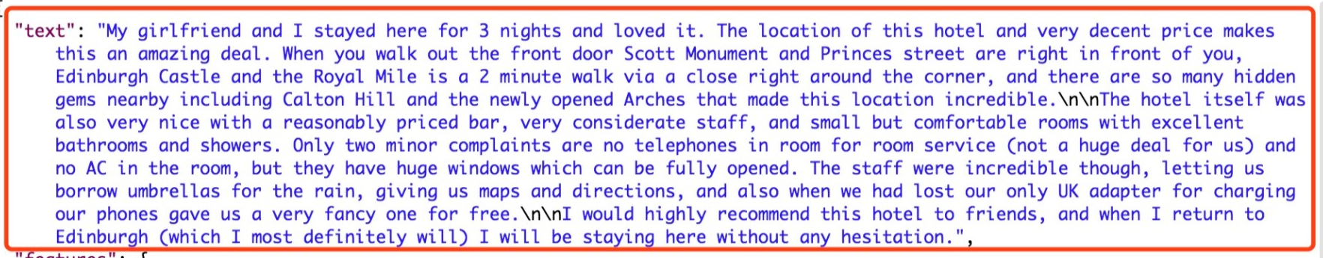
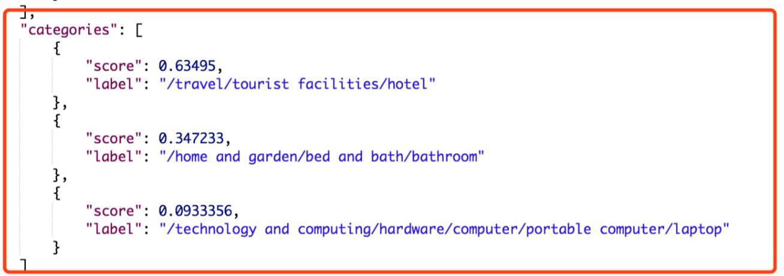
Create the UI
Notes:
We are going to create an user interface for the user to classify documents.
Currently, we use the neural network API provided by Bluemix to classify the input documents. As you can see on this screen.

Slide 21
Zijing Huang, Po-Hsun Chen,
Hao-Wei Chen, Chao Shu
Department of Computer Science
2017.10.30

